Slide 1


PY-EXPO
2K24
Team ID: T013
Team Name:SILICONSYNERGY
Genius innovation leaves behind a legacy...
PYEXPO 2K24

Slide 2
PS Code: PY139
Problem Statement:
Developing web application for real time sensor data visualization using flask and MQTT
02
PYEXPO 2K24

Slide 3
Solution
Describe your idea/Solution/Prototype here
The dedicated website is to visualize the real time data.
the application consists of:
1.to determine the quantity of environmental panel.
2.to monitoring the system in industrial panel
Technology Stack
Front end development: html, css
Back end development: Flask
03
PYEXPO 2K24

Slide 4
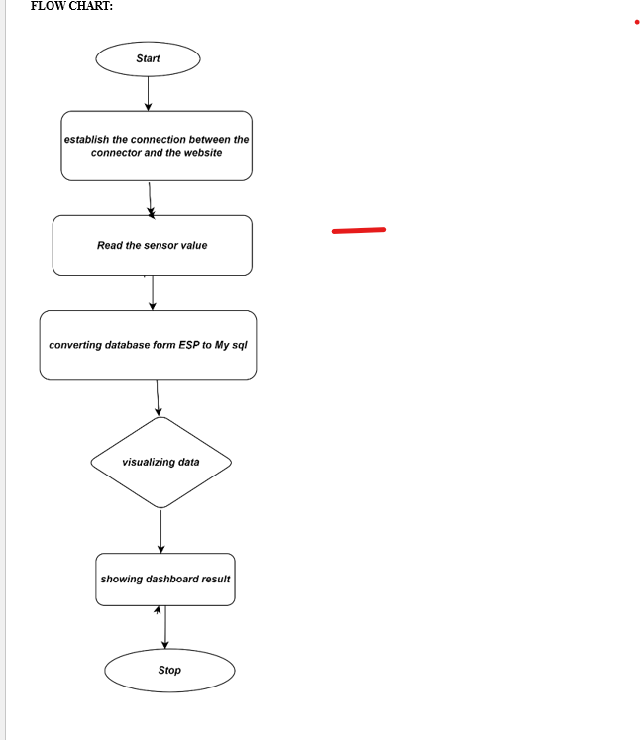
04
PYEXPO 2K24

Slide 5
Sensor Data Collection: Implement a system for collecting sensor data from IoT devices using the MQTT protocol. This may involve setting up MQTT brokers and clients to facilitate communication between sensors and the web application.
Web Application Development: Develop a web application using the Flask framework in Python to serve as the frontend interface for visualizing sensor data. The application should include:
User authentication and authorization mechanisms to ensure secure access to sensor data.
Real-time data visualization capabilities using interactive charts, graphs, and dashboards to display sensor readings.
Support for dynamic updates to the web interface as new sensor data becomes available.
Integration with MQTT to subscribe to sensor data topics and receive updates in real-time.
Data Processing and Analysis: Implement backend functionality to process and analyze incoming sensor data before visualization. This may involve:
Data preprocessing steps such as filtering, aggregation, or normalization to prepare the data for visualization.
Implementing algorithms for detecting anomalies or patterns in the sensor data to provide insights to users.
Scalability and Performance: Design the web application and underlying infrastructure to handle large volumes of sensor data and concurrent user requests efficiently. Consider optimizations such as asynchronous processing, caching, and load balancing to ensure scalability and performance.
PYEXPO 2K24

Slide 6
Team Member Details:
Team Member Details
1. Anbalan M(23AIA07)
2. Ezhil Nilavan NG(23AIA25)
3. Eric Abishek CL(23AIA24)
4. Bharathi M (23AIA15)
5. Gowsigan P(23ME14)
05
PYEXPO 2K24

Slide 7

Thank You
Any Queries?
PYEXPO 2K24

Slide 8
Important Pointers
Please ensure the below pointers are met while
Kindly keep the maximum slide limit to 7 pages
All the topics should be utilized for the description of your idea
Try to avoid paragraphs and post your idea in points
Keep your explanation precisely and easy to understand
The idea should be unique and novel. If it has a business potential more weightage will be given.
Apart from this PPT abstract of your idea will be asked for separately while submitting
You need to save the file in PDF and upload the same on the portal. No PPT, Word Doc or any other format will be supported
You can delete this slide (Important Pointers) when you upload the details of your idea on the devfolio portal.

